Slide 1

BDM 411:BUSINESS INTELLIGENCE AND ANALYTICS LECTURE 3: BIG DATA ANALYTICS AND DATA MINING

Slide 2
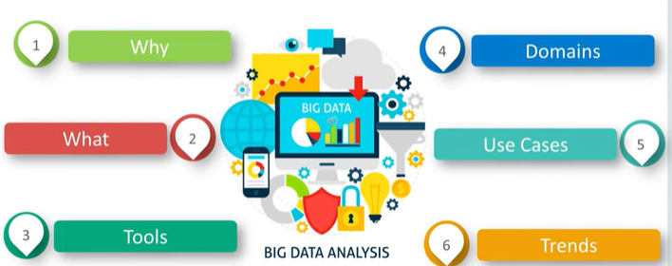
INTRODUCTION TO BIG DATA ANALYTICS

Slide 3

INTRODUCTION TO BIG DATA ANALYTICS
Definition:
Refers to datasets whose size is beyond the ability of typical database software tools to capture, store, manage and analyze.
Sedkaouli S. (2018)

Slide 4
INTRODUCTION TO BIG DATA
Big Data is created digitally and collected automatically
Large amounts of data are collected and organized to benefit an organization and their user clients
Big Data Resources are built from scratch. No data and no big data technologies exist before big data
Sedkaouli S. (2018)

Slide 5
Business Analytics, BI, Big Data, Data Mining - What’s the difference?
Business Analytics – Tools to explore past data to gain insight into future business decisions.
BI – Tools and techniques to turn data into meaningful information.
Big Data –data sets that are so large or complex that traditional data processing applications are inadequate.
Data Mining - Tools for discovering patterns in large data sets.

Slide 6
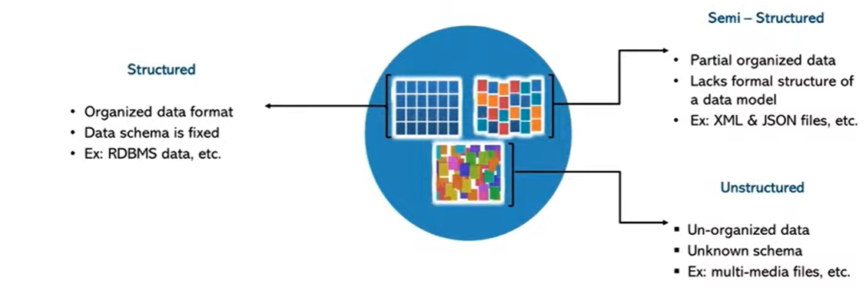
INTRODUCTION TO BIG DATA

Slide 7
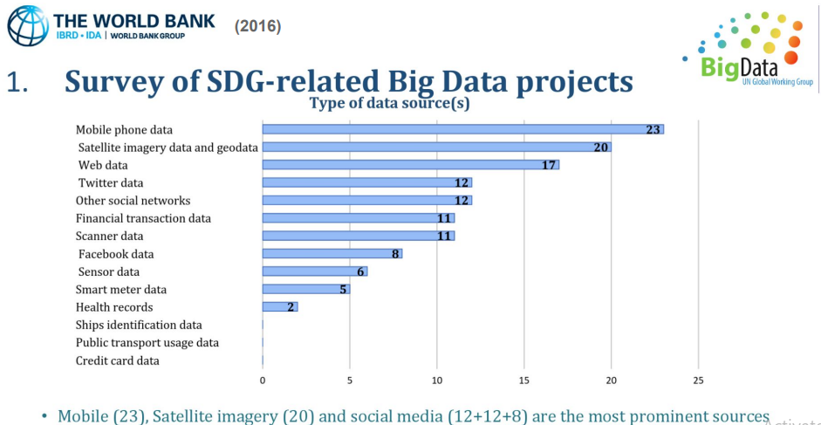
INTRODUCTION TO BIG DATA

Slide 8
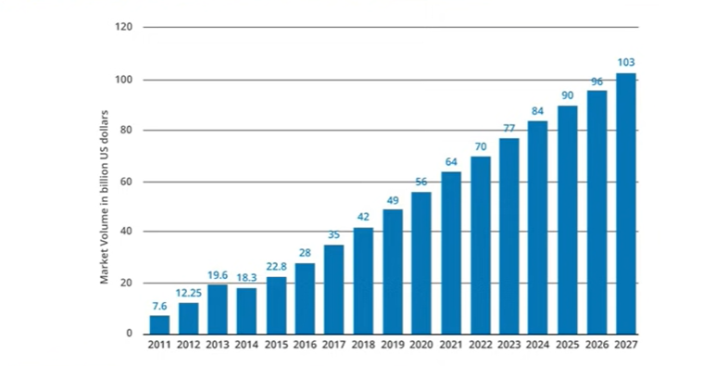
BIG DATA MARKET REVENUE

Slide 9
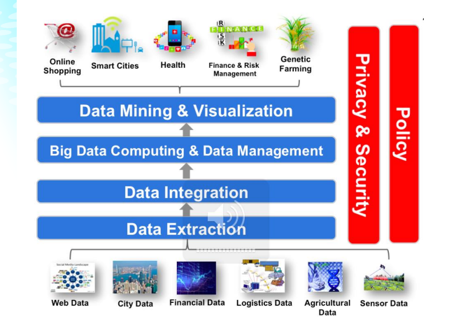
BIG DATA ANALYTICS PROCESS AND OBJECTIGES

Slide 10
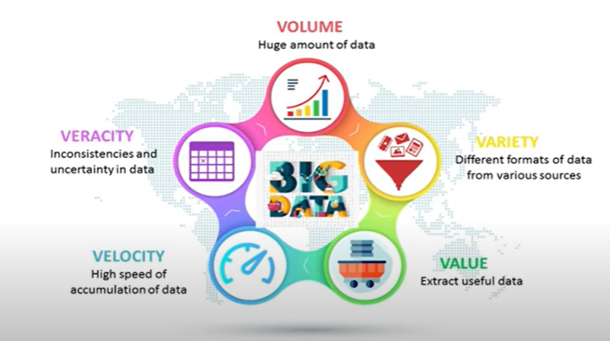
CHARACTERISTICS OF BIG DATA

Slide 11
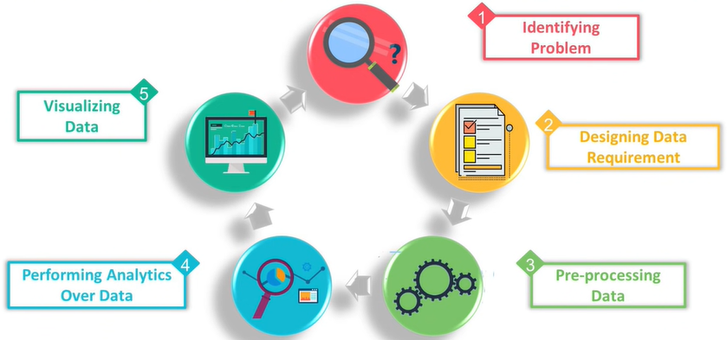
STAGES OF BIG DATA ANALYTICS

Slide 12
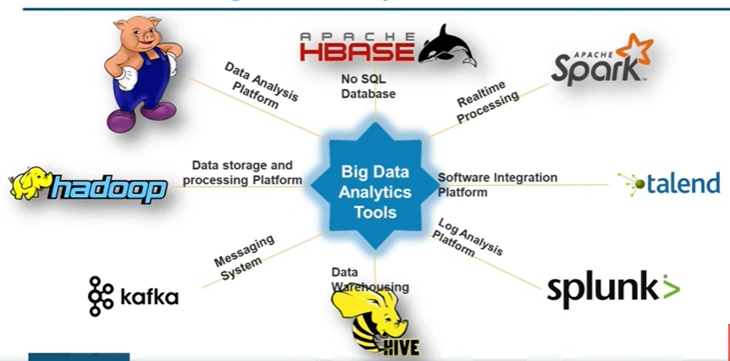
TOOLS USED IN BIG DATA ANALYTICS

Slide 13
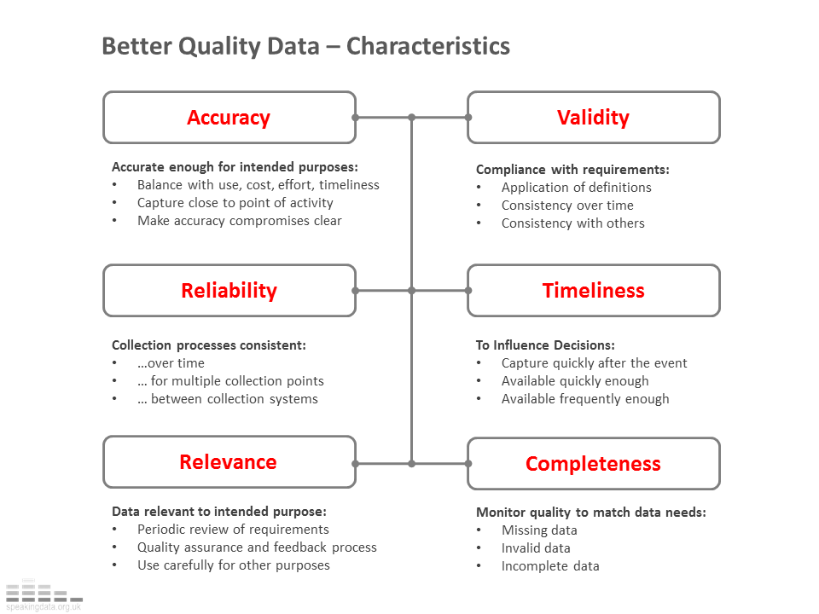
Characteristics of Data for Good Decision Making
Source: speakingdata blog

Slide 14
LECTURE 3: INTRODUCTION DATA MINING

Slide 15
OUTLINE
Tasks in Data mining
Data mining Process
Classification of Data mining Systems
Major issues in Data mining

Slide 16
Introduction
Data Mining is a process of discovering various models, summaries, and derived values from a given collection of data.
The general experimental procedure adapted to data-mining problems involves the following steps:

Slide 17
Tasks in Data mining
Data mining involves six common classes of tasks:
Anomaly detection (Outlier/change/deviation detection) – The identification of unusual data records, that might be interesting or data errors that require further investigation.
Association rule learning (Dependency modelling) – Searches for relationships between variables. For example a supermarket might gather data on customer purchasing habits. Using association rule learning, the supermarket can determine which products are frequently bought together and use this information for marketing purposes. This is sometimes referred to as market basket analysis.
Clustering – is the task of discovering groups and structures in the data that are in some way or another "similar", without using known structures in the data.

Slide 18
Tasks in Data mining
Classification – is the task of generalizing known structure to apply to new data. For example, an e-mail program might attempt to classify an e-mail as "legitimate" or as "spam".
Regression – attempts to find a function which models the data with the least error.
Summarization – providing a more compact representation of the data set, including visualization and report generation.

Slide 19
Data mining Process
State the problem and formulate the hypothesis
Gathering domain-specific knowledge and experience are usually necessary in order to come up with a meaningful problem statement.
The modeler usually specifies a set of variables for the unknown dependency and, if possible, a general form of this dependency as an initial hypothesis.
Close interaction between the data-mining expert and the application expert.

Slide 20
Data mining Process
2. Collect the data
Concerned with Generation and gathering of data
In general, there are two distinct possibilities:
The first is when the data-generation process is under the control of an expert (modeler): this approach is known as a designed experiment.
The second possibility is when the expert cannot influence the data- generation process: this is known as the observational approach.

Slide 21
Data mining Process
3. Preprocessing the data
In the observational setting, data are usually "collected" from the existing databses, data warehouses, and data marts. Data preprocessing usually includes at least two common tasks:
Outlier detection (and removal) – Outliers are unusual data values that are not consistent with most observations.
Commonly, outliers result from measurement errors, coding and recording errors, and, sometimes, are natural, abnormal values.

Slide 22
Data mining Process
3. Preprocessing the data Cont’d
Scaling, encoding, and selecting features – Data preprocessing includes several steps such as variable scaling and different types of encoding.
For example, one feature with the range [0, 1] and the other with the range [−100, 1000] will not have the same weights in the applied technique;

Slide 23
Data mining Process
4. Estimate the model
The selection and implementation of the appropriate data-mining technique is the main task in this phase.
This process is not straightforward; usually, in practice, the implementation is based on several models, and selecting the best one is an additional task.

Slide 24
Data mining Process
5. Interpret the model and draw conclusions
Modern data-mining methods are expected to yield highly accurate results using high dimensional models.
The problem of interpreting these models, also very important, is considered a separate task, with specific techniques to validate the results.

Slide 25
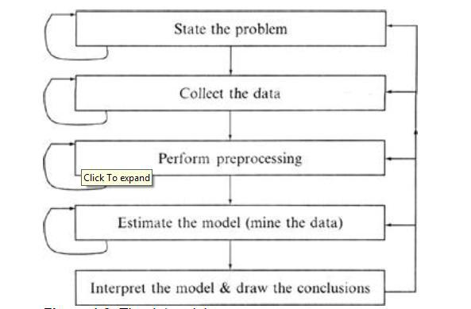
Data mining Process

Slide 26
Data Cleaning techniques
Data Integration techniques
Data Transformation techniques
Data Reduction techniques

Slide 27
Data Preprocessing Techniques
Data Cleaning techniques
Data Integration techniques
Data Transformation techniques
Data Reduction techniques

Slide 28
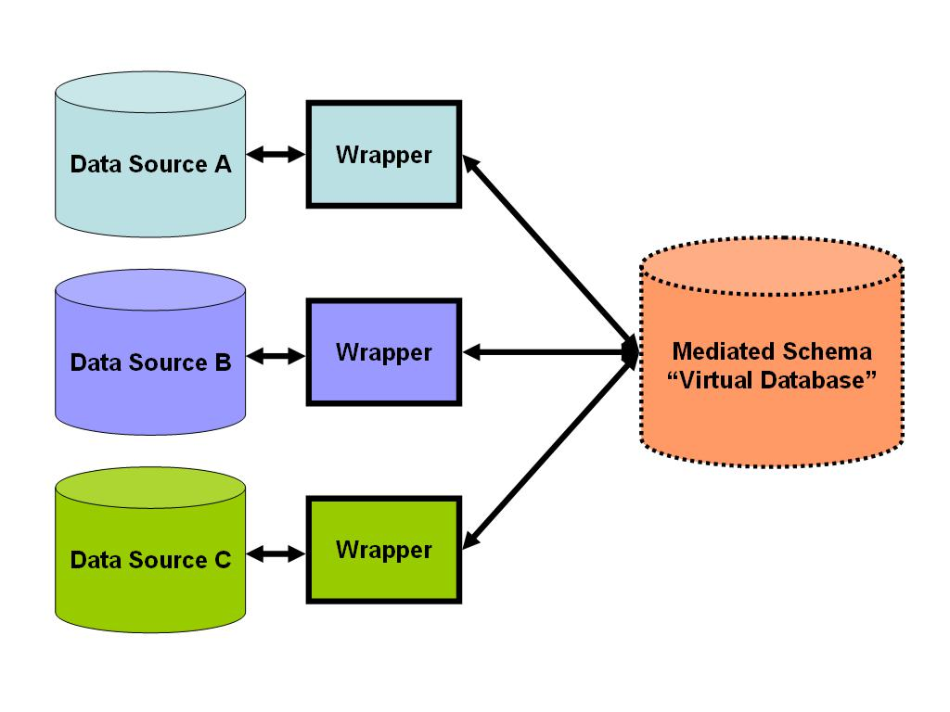
Data Preprocessing Techniques-Integration
Data Integration:
It combines data from multiple sources into a coherent data store, as in data warehousing.
These sources may include multiple databases, data cubes, or flat files.

Slide 29
Data Preprocessing Techniques-Integration
Issues in Data integration:
Schema integration and object matching: How can the data analyst or the computer be sure that customer id in one database and customer number in another reference to the same attribute.
Redundancy:
An attribute (such as annual revenue, for instance) may be redundant if it can be derived from another attribute or set of attributes. Inconsistencies in attribute or dimension naming can also cause redundancies in the resulting data set.
Detection and resolution of data value conflicts:
For the same real-world entity, attribute values from different sources may differ.

Slide 30
Data Preprocessing Techniques-Data Transformation
In data transformation, the data are transformed or consolidated into forms appropriate for mining.
Data transformation can involve the following:
Smoothing, this works to remove noise from the data. Such techniques include binning, regression, and clustering
Aggregation, where summary or aggregation operations are applied to the data. For example, the daily sales data may be aggregated so as to compute monthly and annual total amounts. This step is typically used in constructing a data cube for analysis of the data at multiple granularities.

Slide 31
Data Preprocessing Techniques-Data Transformation
Generalization of the data, where low-level or ―primitive‖ (raw) data are replaced by higher-level concepts through the use of concept hierarchies. For example, categorical attributes, like street, can be generalized to higher-level concepts, like city or country.
Normalization, where the attribute data are scaled so as to fall within a small specified range, such as 1:0 to 1:0, or 0:0 to 1:0.
Attribute construction (or feature construction),where new attributes are constructed and added from the given set of attributes to help the mining process.

Slide 32
Data Preprocessing Techniques-Data Reduction
Data reduction techniques can be applied to obtain a reduced representation of the data set that is much smaller in volume, yet closely maintains the integrity of the original data.
That is, mining on the reduced data set should be more efficient yet produce the same (or almost the same) analytical results.

Slide 33
Data Preprocessing Techniques-Data Reduction
Strategies for data reduction include the following:
Data cube aggregation, where aggregation operations are applied to the data in the construction of a data cube.
Attribute subset selection, where irrelevant, weakly relevant, or redundant attributes or dimensions may be detected and removed.
Dimensionality reduction, where encoding mechanisms are used to reduce the dataset size.
Numerosity reduction, where the data are replaced or estimated by alternative, smaller data representations such as parametric models (which need store only the model parameters instead of the actual data) or nonparametric methods such as clustering, sampling, and the use of histograms.

Slide 34
Classification of Data mining Systems
The data mining system can be classified according to the following criteria:
Database Technology
Statistics
Machine Learning
Information Science
Visualization
Other Disciplines

Slide 35
Data mining Classifications
Some Other Classification Criteria:
Classification according to kind of databases mined
Classification according to kind of knowledge mined
Classification according to kinds of techniques utilized
Classification according to applications adapted

Slide 36
Data mining Classifications
Classification according to kind of databases mined
We can classify the data mining system according to kind of databases mined.
Database system can be classified according to different criteria such as data models, types of data etc. And the data mining system can be classified accordingly.
For example if we classify the database according to data model then we may have a relational, transactional, object- relational, or data warehouse mining system.

Slide 37
Data mining Classifications
Classification according to kind of knowledge mined
We can classify the data mining system according to kind of knowledge mined. It is means data mining system are classified on the basis of functionalities such as:
Characterization
Discrimination
Association and Correlation Analysis
Classification
Prediction
Clustering
Outlier Analysis
Evolution Analysis

Slide 38
Data mining Classifications
Classification according to kinds of techniques utilized
We can classify the data mining system according to kind of techniques used.
We can describes these techniques according to degree of user interaction involved or the methods of analysis employed.

Slide 39
Data mining Classifications
Classification according to applications adapted
We can classify the data mining system according to application adapted. These applications are as follows:
Finance
Telecommunications
DNA
Stock Markets
E-mail

Slide 40
Major issues in Data Mining
Mining different kinds of knowledge in databases: -
The need of different users is not the same. And Different user may be in interested in different kind of knowledge. Therefore it is necessary for data mining to cover broad range of knowledge discovery task.
Interactive mining of knowledge at multiple levels of abstraction: - The data mining process needs to be interactive because it allows users to focus the search for patterns, providing and refining data mining requests based on returned results.

Slide 41
Major issues in Data Mining
Incorporation of background knowledge: -
To guide discovery process and to express the discovered patterns, the background knowledge can be used. Background knowledge may be used to express the discovered patterns not only in concise terms but at multiple level of abstraction.
Data mining query languages and ad hoc data mining:-
Data Mining Query language that allows the user to describe ad hoc mining tasks, should be integrated with a data warehouse query language and optimized for efficient and flexible data mining.

Slide 42
Major issues in Data Mining
Presentation and visualization of data mining results:- Once the patterns are discovered it needs to be expressed in high level languages, visual representations. These representations should be easily understandable by the users.
Handling noisy or incomplete data: - The data cleaning methods are required that can handle the noise, incomplete objects while mining the data regularities. If data cleaning methods are not there then the accuracy of the discovered patterns will be poor.

Slide 43
Major issues in Data Mining
Pattern evaluation:- It refers to interestingness of the problem. The patterns discovered should be interesting because either they represent common knowledge or lack novelty.
Efficiency and scalability of data mining algorithms:- In order to effectively extract the information from huge amount of data in databases, data mining algorithm must be efficient and scalable.

Slide 44
Businesses Need Support for Decision Making
Uncertain economics
Rapidly changing environments
Global competition
Demanding customers
Taking advantage of information acquired by companies is a Critical Success Factor.

Slide 45
The Information Gap
The shortfall between gathering information and using it for decision making.
Firms have inadequate data warehouses.
Business Analysts spend 2 days a week gathering and formatting data, instead of performing analysis. (Data Warehousing Institute).
Business Intelligence (BI) seeks to bridge the information gap.

Slide 46

Summary
Explained BI, Analytics, Data Marts and Big Data.
Defined the characteristics of data for good decision making.
Described data mining in detail.
Explained and gave examples of market basket and cluster analysis.

Slide 47
REVIEW QUESTIONS
Discuss the relationship between Digital transformation and Business Intelligence
Summarize the benefits of Business intelligence in an organization in the 21st Century
Differentiate Digital transformation and Business Intelligence
Discuss the Porters Five Forces in relation to the Business intelligence
Choose one Sector of Economy in Kenya and discuss how Business Intelligence has been used to achieve efficiency in Operations

Slide 48
CASE STUDY
From the Case Study:
ADDRESSING 4 CORE BUSINESS INTELLIGENCE CHALLENGES ON THE SEARCH FOR ACTIONABLE INSIGHTS By Jennifer Bresnick
Discuss the four Core Business Intelligence Challenges faced by the organizations today.
Propose the specific solutions to the above challenges

